Slide 1



Dr. Babasaheb Ambedkar technological university’s institute of pertrochemical engineering department of information technology Seminar on ROVER technology
Presented by : Shruti Sanjay Gurav
Roll no: 2201929
PRN: 2030408246053

Slide 2
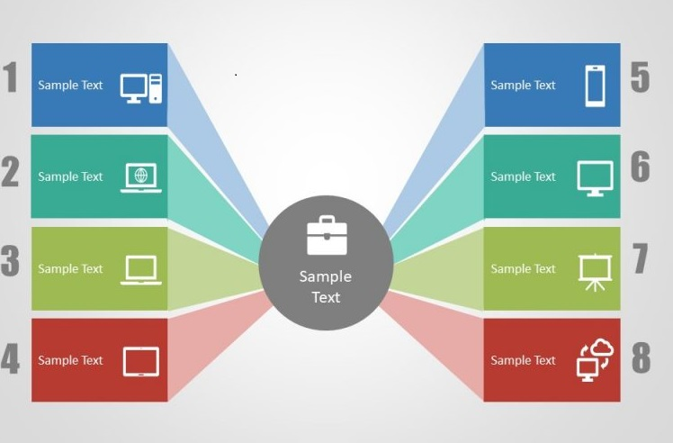
Content
Introduction
Rover controller
Rover client
Rover database
Content
Rover service
Action model
Rover architecture
Conclusion

Slide 3


INTRODUCTION
“ROVER” Stand for Remotely Operated Video Enhanced Receiver system.
It is an location-aware computing which involves the automatic availability of information and services based on a current location of the user.

Slide 4
INTRODUCTION..
We have designed and implemented Rover,a system that enables location based services,as well as traditional time aware,user-aware & device-aware services…

Slide 5
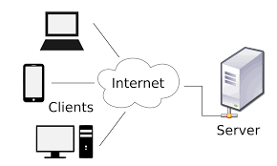
Rover clients
The Rover Technology can be ranging from powerfull laptops to simple cellular phones.
They are categorized by…
◦Display properties
◦Text and graphics capability
◦Image compression, audio and video delivery capabilities

Slide 6

ROVER SERVICES
The services provided by Rover to its users can be classified as follows:-
◦ Basic data service
◦ Transactional service
◦ Map-based service

Slide 7
Services..
Basic data service:-
It enables services in different media formats including text,graphics,audio,and video.
Transactional service:-
It is a coordination of state between the clients and rover servers .ex) e-commerce interaction.

Slide 8
services
Map based services:-
Filter: Applied to maps to select the appropriate subset of objects to display to users.
Zoom: Displyed map identifies its granularity.
Translate: Translate from previously displayed map.

Slide 9
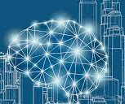
Rover architecture
Rover maintains a user profile for each end user,that defines specific interests of the user and is used to customize the content served.
Rover-clients are the client devices through which users interact with rover.
Rover maintains a device profile for each device

Slide 10
Rover architecture
●There are two types of Rover Architecture :
1]Rover physical architecture
2]Rover logical architecture.

Slide 11
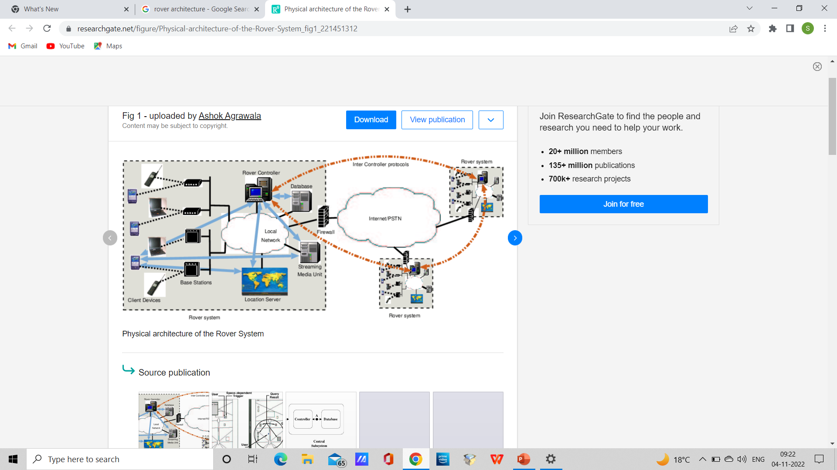
Rover Physical Architecture

Slide 12
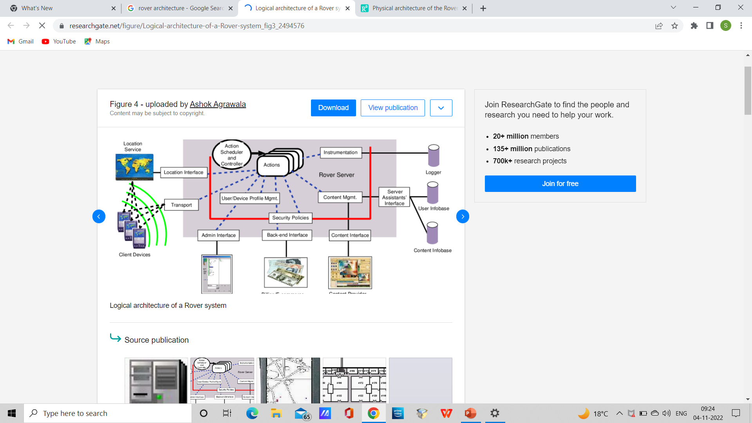
Rover Logical Architecture

Slide 13
Rover controller
Rover controller interacts with components of system through following interfaces:
◦Location Interface
◦Admin Interface
◦Content Interface
◦Back-end Interface
◦Transport Interface

Slide 14
Rover controller
Location Interface: This interface is used by Rover Controller to query the location service about positions of client devices.
Admin Interface:This interface is used by the administrator to over see the rover system,including monitoring Rover Controller,quering client devicces,updating security policies.
Content Interface: This interface is used by content provider to update content that is seved by rover controller to client device.

Slide 15
Rover controller
Backend Interface: This interface used for interaction between rover controller and external services may be required.
Transport Interface:This is communication interface between rover controller and the clients which identify data formats.

Slide 16
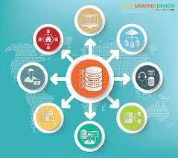
Rover database
The database in rover consists of two components:
1]User Infobase
2]Content Infobase

Slide 17
Rover database
User Infobase:
One component of the database is the user infobase,which maintains user and device information of all active users and device in the system.It contains all client-specific context of the users and devices,namely profiles and preference,client location,and triggers set by the clients.

Slide 18
Rover database
Content Infobase:
The other component in database is the content infobase.This stores the content that is served by the rover controller and changes less frequently.The content provider of the rover system is responsible for keeping this infobase updated.

Slide 19
Action model
Allows Rover Systems to scale to large user populations by allowing real-time application specific scheduling of tasks.
Scheduling is done in atomic units called actions.
An action is a small piece of code.
Sequence of action is server operation.

Slide 20
Action model(cont..)
There are three states of action model:
1)Ready to run
2)Running
3)Blocked

Slide 21
Action model (cont..)
Ready to run:
At least one action of server operation is eligible to be executed but no action of the server operation is executing.
●Running:
One action of the server operation is executing(in a multi-processor setup,several actions of the operation can be executing
Simultaneously.

Slide 22
Action model(cont..)
Blocked:
The server operation is waiting for asynchronous I/O response and no actions are eligible to be executed.

Slide 23
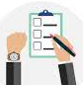
conclusion
We believe that Rover Technology will greatly enhance the user experience in a large number places,including visits to museums,shopping malls,offices and business centers.
The system has been designed specially for user location aware and to scale large user populations.

Slide 24

THANK YOU

